Slide 1
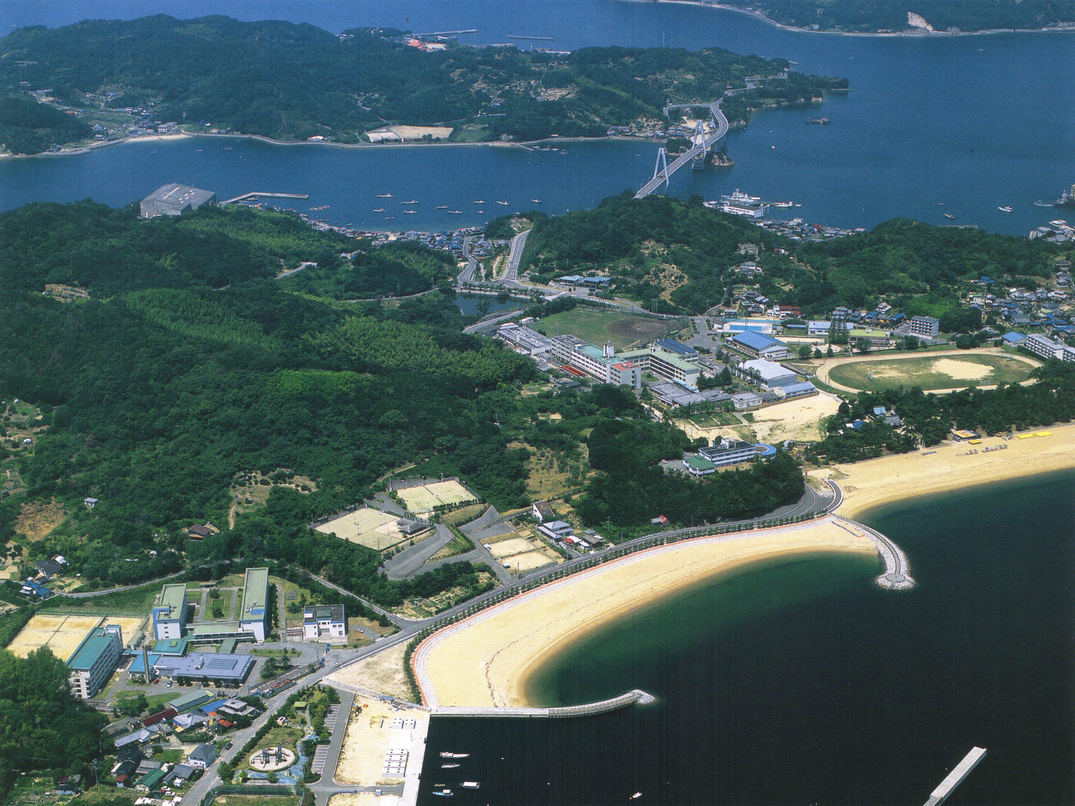
National Institute of Technology, Yuge College
NIT, Yuge College established in 1901
独立行政法人国立高等専門学校機構
弓削商船高等専門学校

Slide 2

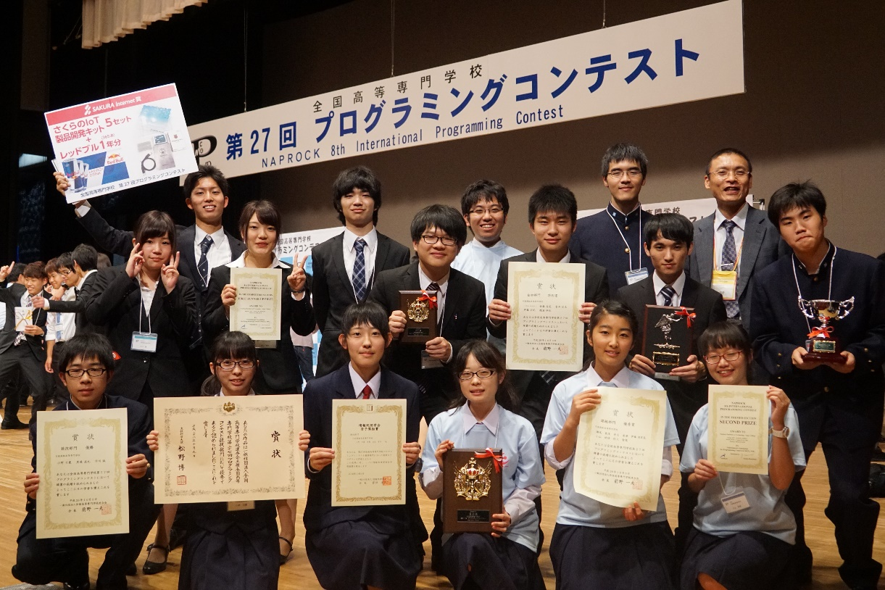
Self introduction
Name: Calvin Janitra Halim
Hometown: Medan, Indonesia
Transferring to: Chiba University
Club activity: Micom Club

Slide 3


Self introduction
Name: Hayate Nakayama
Hometown: Innoshima, Japan
Transferring to: Ehime University
Club activity: Cutter Boat

Slide 4
Where is National Institute of Technology(NIT), Yuge College?
NIT, Yuge College is in the Yuge Island, Ehime Prefecture, Shikoku.
Osaka
Tokyo
Shikoku Region
the Yuge Island
about 800km from Tokyo
5 hours from Tokyo
ーbullet train 3.5 h, highway bus 1.5h, rapid boat 10min.

Slide 5
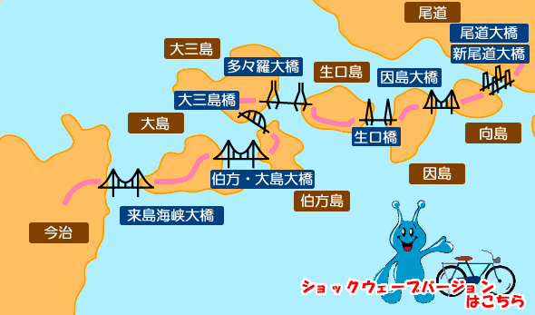
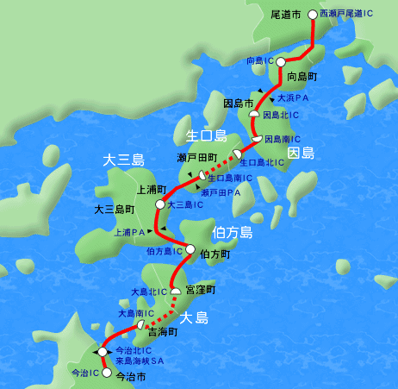
Shimanami Area
7 bridges
6 islands
the Yuge Island

Slide 6
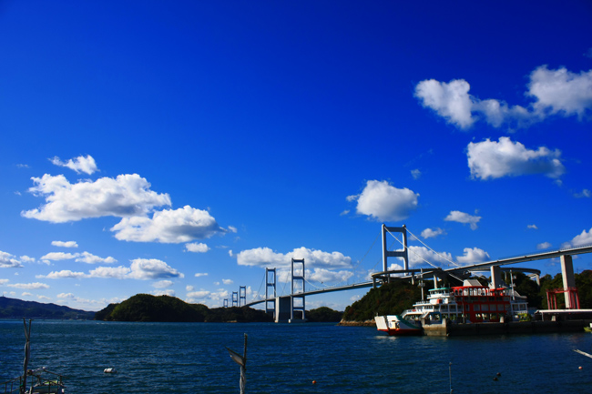
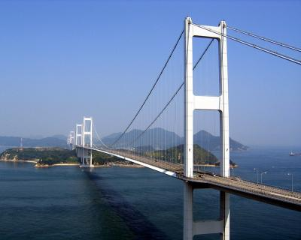



Slide 7


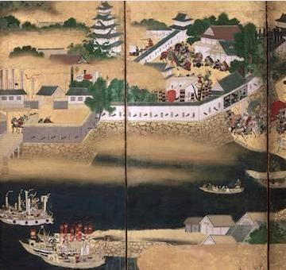


Slide 8
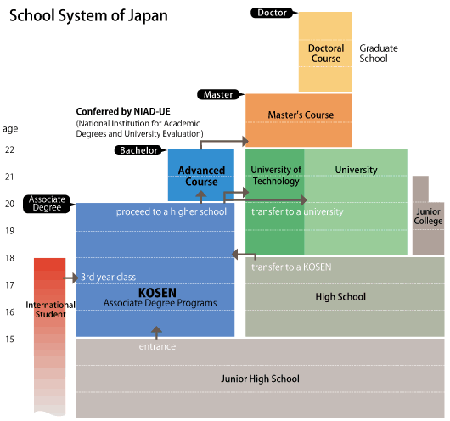
KOSEN (Colleges of Technology)
KOSEN: five-year engineering education from 15 years old - were established in 1961, in response to a strong demand from the industrial sector to foster engineers who sustained the high Japanese economic growth at that time.
The first 12 national colleges were founded in 1962, and the number increased to 43 by 1965.
A two-year advanced course system was introduced in 1991.
In 2004, the Institute of National Colleges of Technology was inaugurated to manage 55 national KOSEN throughout Japan.
Approximately 300,000 students have graduated so far, contributing actively not only in the industrial world but also in the academic sector, as engineers, researchers, managers and so on.
Advanced Course
A two-year course where higher education in engineering is conducted.
Most graduates in the course receive bachelor’s degrees from the National Institution for Academic Degrees and University Evaluation (NIAD-UE).
We accept approximately 1,500 students every year and students number are approximately 3,000 in total.
Approximately 2/3 of the graduates obtain employment.
The ratio of job openings to job seekers is approximately 4:5 (2009.3).
Approximately 1/3 of them go to postgraduate schools.

Slide 9
National Institute of Technology (NIT), Yuge College is one of the greatest colleges in the world.
Why?
The First Reason is…
Our Campus is surrounded by the beautiful sea, and nature.
Our Campus is in the Yuge Island, an Isolated Island.
Our Campus is in the National Park.
Our Campus is next to the beach!!

Slide 10
National Institute of Technology(NIT), Yuge College Has Two Courses
Main Course : 5 year consistent education
High School (3 years) ＋Junior College (2 years)
Advanced Engineering Course : 2 years
Bachelor Course after graduating from Main Course
Our College has 600 students in total.
Our mission is to train Practical Maritime Engineers,
Mechanical Engineers, and IT engineers.

Slide 11
Maritime Technology Department
Training Maritime Engineers
such as Sea Captains and Chief Engineers
Electronic Mechanical Engineering Department
Training Frontier Electronic Mechanical Engineers
Mechatronics Integrating Mechanical Engineering and Electronics
Information Science and Technology Department
Training Practical IT Engineers
Information Processing, Electronics and Applied Computer Technology

Slide 12
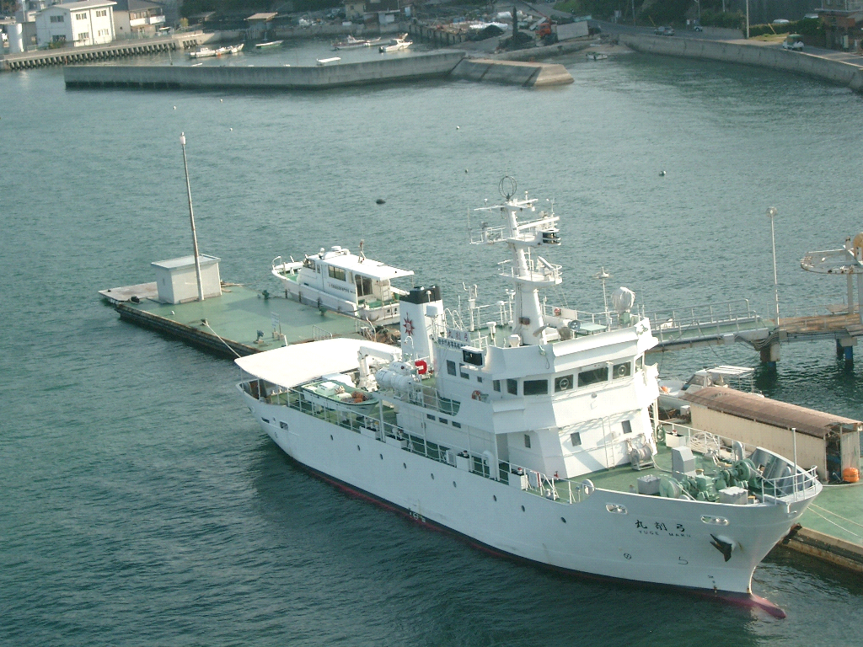
The Second Reason is…
Our College has Special Facilities.
・Computer Education Center (Free Internet)
・Library (more than 73,000 books)
・Training Workshops (Welding Robots, YAG Laser Cutter…)
Ship Navigation Simulator
Training Ship “YUGEMARU” （240t）
Training Rapid Boat “HAMAKAZE” (16t)

Slide 13
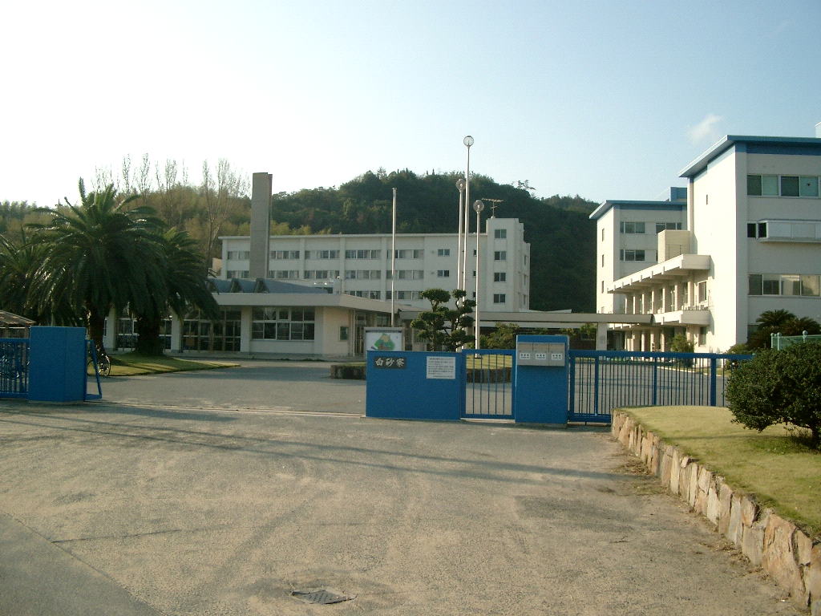
The Third Reason is…
Our College has Dormitory.
About 400 students (70% of the students) live there.
Teachers take care of students by staying overnight there.
The first-year students : Twin/Triple/Quartet Room
The senior students : Mainly Single Room
Dormitory plays a role of education.

Slide 14
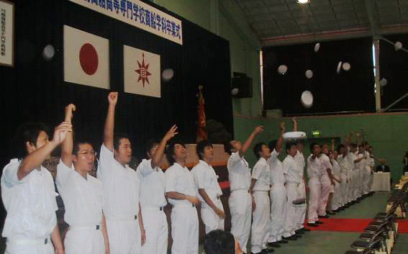
The Fourth Reason is…
Students Can Get Good Employment.
N.Y.K. Nippon Yusen Kaisha
M.O.L. Shosen Mitsui
Nittsu Nippon Express
Panasonic
Mitsubishi Electronics
OLYMPUS
Mazda
JR West Japan
Osaka Gas
Iyo Bank etc…

Slide 15
The Fifth Reason is…
Students Can Transfer to National Universities
Tokyo University of Marine Science and Technology
Osaka University
Tokyo Institute of Technology
Tsukuba University
Chiba University
Ehime University
Kobe University
Hiroshima University
Toyohashi University of Technology
Nagaoka University of Technology
Kyushu University of Technology

Slide 16
The Sixth Reason is…
Our College is International.
Academic Exchange Agreement with
Mongolian University of Science and Technology,
Nakhon Phanom University, Thailand.
10 students from abroad
Mongolia
Malaysia (5 students)
Indonesia
Laos
Thailand (2 students)

Slide 17
International Students by Countries

Slide 18
Club Activities
17 Sports Clubs
14 Cultural Clubs
4 group activities
Cutter Club
Yacht Racing Club

Slide 19
Thank you very much for your kind attention!
We hope you enjoy your stay here at Yuge!

